Slide 1
Implementing Lists
dynamic array Edition

Slide 2
Dynamic Arrays
Dynamic array: An array that can change size as required
Not a native component, need to be coded
Java’s API version: The ArrayList class
When the array runs out of space:
Make a bigger array
Copy everything from the original array over to the new array
Store the new array in the original array’s place/variable name
Benefit of a dynamic array: Efficient direct access to information
An array is a single continuous section of memory, can directly access any specific section within it with ease
Just like in Algorithms!

Slide 3
Implementing a Dynamic Array: Data Storage
Need a minimum of one component:
The array to store information
How big should this array be to start?

Slide 4
Storing Data: The Internal Array
The list’s internal array needs a starting size
Remember, you have to create an array with a specific size
Two possible approaches:
Start with 0 slots, then grow the array by one slot each time an element is added
Start with a fixed size (e.g. 10 slots), fill that space and when you run out of space, grow the array
Which should we do?

Slide 5
Storing Data: The Internal Array (2)
If we start with 0 slots and grow with every element:
Need to increase the size every time, which means we need to copy the data over every time.
Inefficient, slower option.
Uses up more memory
Best practice: Start with a fixed size and increase by X every time we run out of space
Reduces how many times we need to go through the growth process

Slide 6
Storing Data: Tracking the Data
The list is created with no data, but X (empty) slots
Where should we put the first element?
Where should we put the NEXT element?
We COULD loop to count how many elements we have
While the slot isn’t empty, count and keep looping
How can we tell if a slot is empty?
However, looping to count elements every time is wasteful and slow
Every time someone wants to know the size, we need to count
Every time someone wants to get an element, we need to count
Every time someone wants to add, we need to count
Every time someone wants to remove, we need to count

Slide 7
Storing Data: Tracking the Data (2)
Problem: We need to know how many we have
Solution: Keep a count!
The number of elements currently in the array (i.e. where the array ends)
When we add to the list, increase the count
When we remove from the list, decrease the count

Slide 8
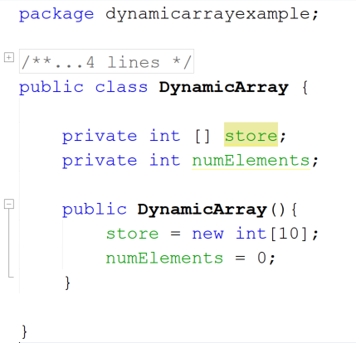
Basic Structure of a Dynamic Array
Array to store information. This is initialized with a small fixed amount of space so we have somewhere to put initial data
int to store how many elements are currently in the array (initialized to 0 as the array starts off empty).
When a new element is added, this should be increased. When an element is removed, it should be decreased.

Slide 9
Implementing a Dynamic Array: Providing List Functionality
Main list functionality:
Find the size
Get an element from a specific position
Add an element
Find an element
Remove an element

Slide 10
Getting the Size of a Dynamic Array
Finding the size of a dynamic array isn’t as simple as returning the length of the array
The array might have empty spots!
Instead, we use the numElements value
numElements is increased when an element is added
numElements is decreased when an element is removed
Returning numElements will give us the size / number of elements in the list

Slide 11
Getting the Element From a Specific Position in a Dynamic Array
Pseudocode:
Check that the supplied position is valid
If it’s not valid, throw an IndexOutOfBoundsException* to alert the programmer that the value is invalid:
throw new IndexOutOfBoundsException();
If it’s valid, return the element at that position
Question: What is a valid position?
Hint: There are two conditions you need to worry about!

Slide 12
Adding to a Dynamic Array
Two approaches to adding:
Adding to the end (easy)
Adding in the middle (more complicated)
We know this one as shift inserting
Adding to the end:
Check if there is enough space in the array to accommodate the new element
If not, copy all existing elements to new, larger, array (aka grow the array)
Add new element to next empty space within array
Increase numElements by 1

Slide 13
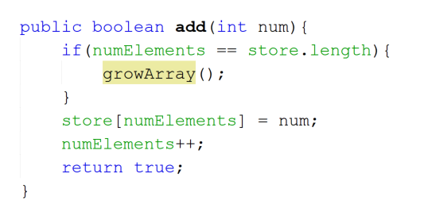
Adding to the End of a Dynamic Array
Validation step:
Confirm we have space!
If we don’t, then we make it
Add to the list and increase the count

Slide 14
Growing Arrays
When we run out of space in the internal array, we need to:
Make a bigger array
Copy over the contents of the array
Revision: What is the algorithm for growing an array?

Slide 15
Revision: Growing Arrays – The Algorithm
What is the algorithm for growing an array?
Make newArray of size originalArray+x
for each element in originalArray:
Put currentElement from currentSlot in originalArray in currentSlot in newArray
Save newArray as originalArray
This must happen every time the array runs out of space, to transfer contents to a bigger version of the array
Big O cost: linear / O(n), because we have to do the operation n times (n is the number of elements in the original array)
Not exactly efficient…
What should x be?

Slide 16
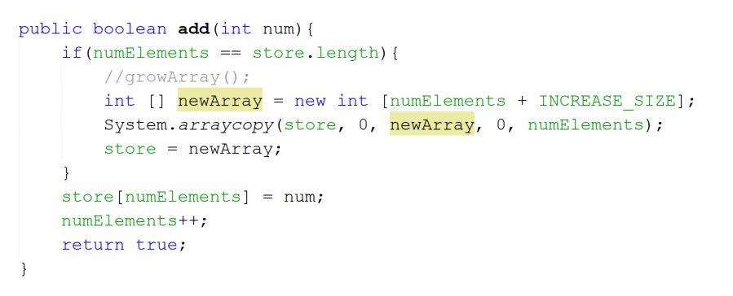
Another Approach – Use the API
This is allowable in Data Structures, but NOT in Algorithms!
The arraycopy method will duplicate data from one array into another one.
Parameters:
store – the source array
0 – What slot number to start copying from
newArray – the destination array
0 – What slot number to start saving into
numElements – the number of elements to copy

Slide 17
Adding to the Middle of a Dynamic Array: The Basic Algorithm – Shift Inserting
Revision: Shift insertion - inserting data into a position in the middle of the array
The basic algorithm (from Algorithms!):
If the slot to be inserted into is valid:
Store the value to be inserted as the prevVal
For each slot from the position being inserted at to the end of the data <- this is slightly different to last semester
Store the element in the current slot to a temp variable
Copy the prevVal into the current slot
Store the contents of the temp variable in the prevVal variable
Move on to the next slot
Increase numElements by 1

Slide 18
Adding to the Middle of a Dynamic Array: What To Worry About
Several situations to consider:
Is the position within the data?
What should happen if it’s not?
Is the position at the END of the data?
Why is this something to specifically consider?
Is there enough space?
If there is not enough space, what should be done?
Each of these conditions need to be accounted for in your algorithm.

Slide 19
Adding to the Middle of a Dynamic Array: Handling Invalid Position Values
Sometimes the position provided as a parameter is not within the bounds of the data
When this happens, react appropriately:
Throw an IndexOutOfBoundsException to alert the programmer that the value is invalid
Notes:
* You will hear more about exceptions in OO Programming

Slide 20
Handling Where There is Insufficient Space
In order to add to an already-full list, you need to grow the array
Create a larger (empty) array
Copy all data from the original array to the new, larger one
Replace the original array with the new, larger one
originalArrayName = newArray;
Two approaches to copying data:
Manual copying (see slide 11)
Using the API method (System.arraycopy) to copy data from one array to another

Slide 21
Finding an Element in the Dynamic Array
Lists are unsorted by default
This means fancy sorting options won’t work!
Only search option that works: Linear search
The basic algorithm (from Algorithms!):
For each element from start of array as far as the end of the data
Check if current element matches what we need
If yes, return this position
If we reach the end of the structure without finding a match
Return -1

Slide 22
Removing From a Dynamic Array
Two approaches to removing:
Removing from a specific position
We know this one as shift deleting
Removing a specific element
Can use the same approach as for removing from a specific position, once we find the position of the element to delete it!

Slide 23
Removing From a Specific Position of a Dynamic Array – Shift Deleting
Revision: Shift deletion - deleting data from a position in the middle of the array
The basic algorithm (amended from Algorithms!):
If the slot to be deleted from is valid:
Save the element in the slot being deleted in a temp variable
For each element from the element being deleted as far as the end of the data
Copy the element in the next slot into the current slot
In other words, copy each element into the slot before it
Wipe the last slot (numElements-1) by overwriting it with a blank
Decrease numElements by 1
Return the value you saved in the temp variable
What is a blank?

